Slide 1
Final Project: MealLogger App Analysis
By Chad Josim

Slide 2

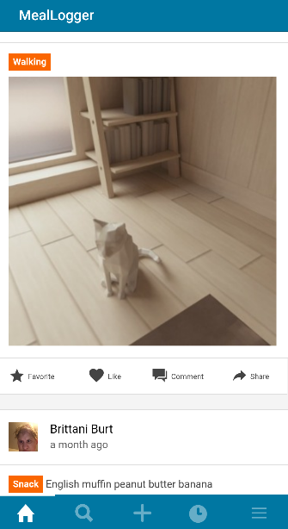
What is MealLogger?
MealLogger is an Android app that works as a photo journal for keeping track of meals and exercise
Main functionalities
Share photos of meals and exercise online with other users
Post online status updates
Join health-related programs and groups
Calendar for tracking calories/activity

Slide 3
Overall Security: Failed!
 | Arch | Storage | Crypto | Auth | Network | Platform | Code | Resilience | Total
Passed | 4 | 2 | 2 | 4 | 3 | 5 | 4 | 2 | 26
Failed | 2 | 13 | 3 | 4 | 2 | 1 | 1 | 5 | 31
N/A | 6 | 0 | 1 | 4 | 1 | 5 | 4 | 6 | 27
Total | 12 | 15 | 6 | 12 | 6 | 11 | 9 | 13 | 84
MealLogger passed only 46% of the applicable/testable standards
Best performers: ARCH, PLATFORM (83%), CODE (80%)
Worst performers: STORAGE (13%), RESILIENCE
For N/A tests, they were outside of the scope of this class or not feasibly testable.

Slide 4

Notable Findings
(the good, the bad, and the ugly)

Slide 5
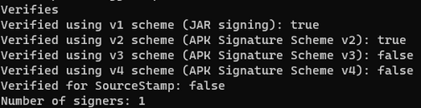
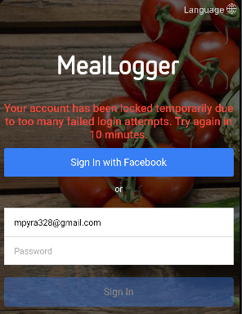
Good Findings
Architecture, Design, and Threat Modeling
Requires the app to be fully updated
Sufficient privacy policy
Platform Interaction
Doesn’t export sensitive functionality through UI, IPC facilities, custom URL schemes, etc.
Code Quality and Build Settings
Signed with valid certificates (V1 and V2)
Not debuggable
Sufficient error/exception handling
Authentication and Session Management
Locks out user after too many failed logins
Services performed at remote endpoint

Slide 6
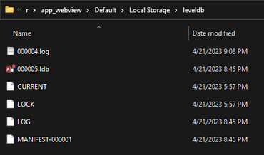
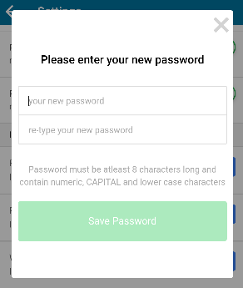
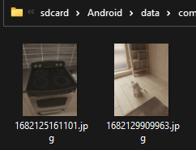
(Very) Bad Findings
Data Storage and Privacy
Stores sensitive data on local device storage
Log files contain sensitive info (DOB, age, weight, etc.)
Keyboard cache not disabled
Lack of minimum device security policy
Cryptography
Hardcoded keys
Outdated hashing services
Authentication and Session Management
Weak password policy
No option for 2FA
Resilience
Insufficient obfuscation scheme
Doesn’t respond to emulator/rooted device

Slide 7
The End!
Any questions?

